Slide 1

Programming Learning App for Kids
R24-109

Slide 2

Research Problem
Sri Lanka is facing a USD price hike [1], impacting several sectors still recovering from the pandemic [2].
Fortunately, IT Sector is still good in Sri Lanka.
Increased outsourcing from larger companies to South Asian countries, primarily India, presents potential challenges [3].
India's large pool of young talent contributing to open-source projects is a potential competitor [4].
Potential knowledge gap between Sri Lankan Teenagers and Indian Teenagers.

Slide 3

Objectives
Main Objective
The primary research objective is to bridge the knowledge gap between our country's students and Indian students, with a focus on producing high-quality and knowledgeable engineers.
Sub Objectives
Exploratory Analysis of Interactive Programming Concepts for Learning
Level-based IT Fundamental Knowledge Evaluation System
Assist kids through a Customized Kids Assistance System.
Teach kids how to progress by a Project-based Programming System.

Slide 4
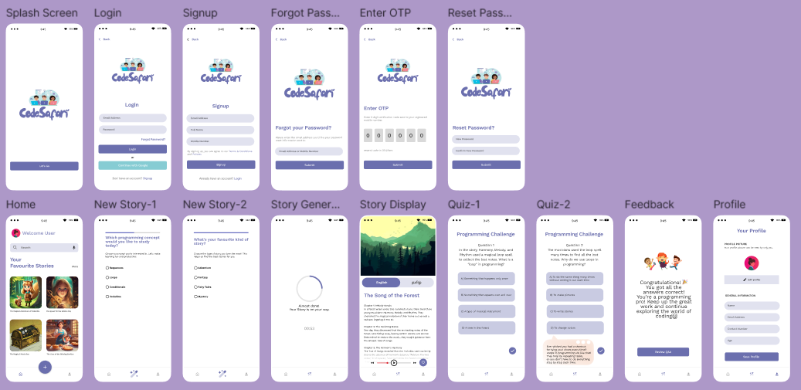
Proposed System

Slide 5
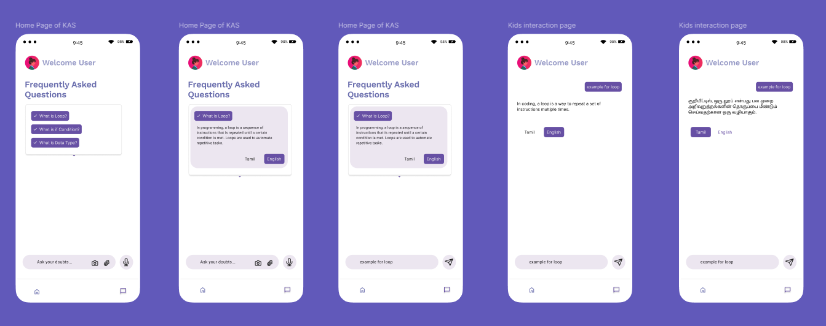
Proposed System Cont’d

Slide 6
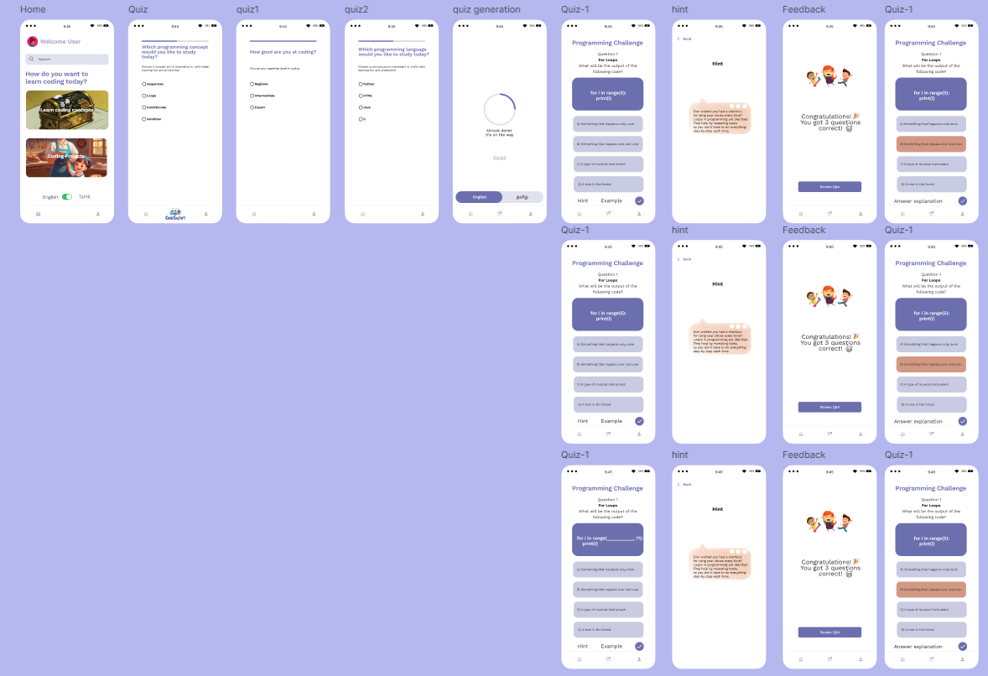
Proposed System Cont’d

Slide 7
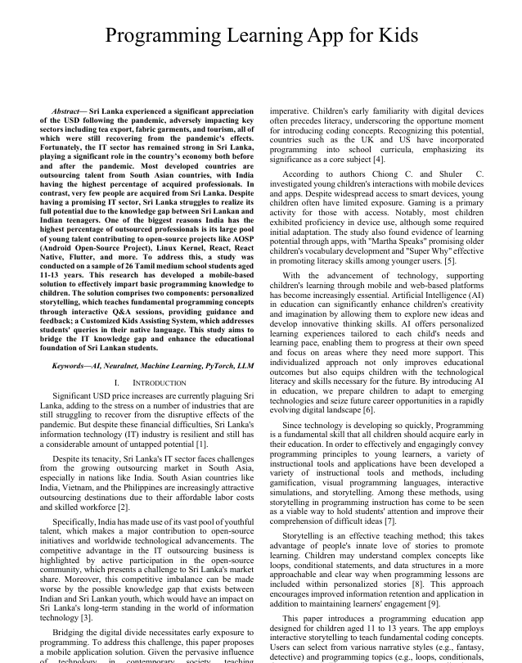
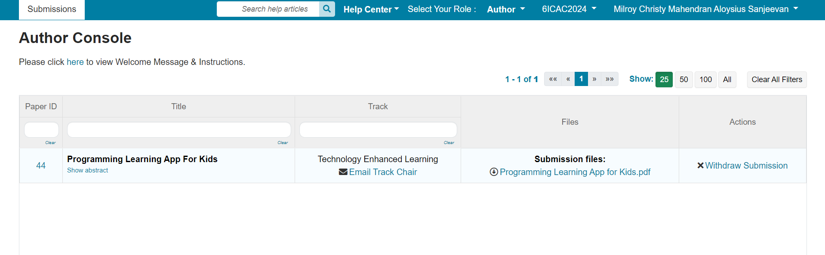
Research Paper

Slide 8

Personalized Story Generation IT21023446 | Sanjeevan m.c.m.a
Software Engineering Specialization
IT21023446 | Sanjeevan M.C.M.A | R24-109

Slide 9






Research Question
Does an interactive mobile application utilizing storytelling and gamification techniques effectively enhance children's understanding of fundamental programming concepts in the learner's native language compared to traditional learning methods?
IT21023446 | Sanjeevan M.C.M.A | R24-109

Slide 10
Specific & Sub Objectives
Develop an interactive mobile application for gamified learning of fundamental programming concepts through storytelling using native language support.
Main Component
Personalized Story Generation Module ☑️
Subcomponents
MCQ Generation Module ☑️
Hint Generation Module ☑️
Feedback Generation Module☑️
IT21023446 | Sanjeevan M.C.M.A | R24-109

Slide 11
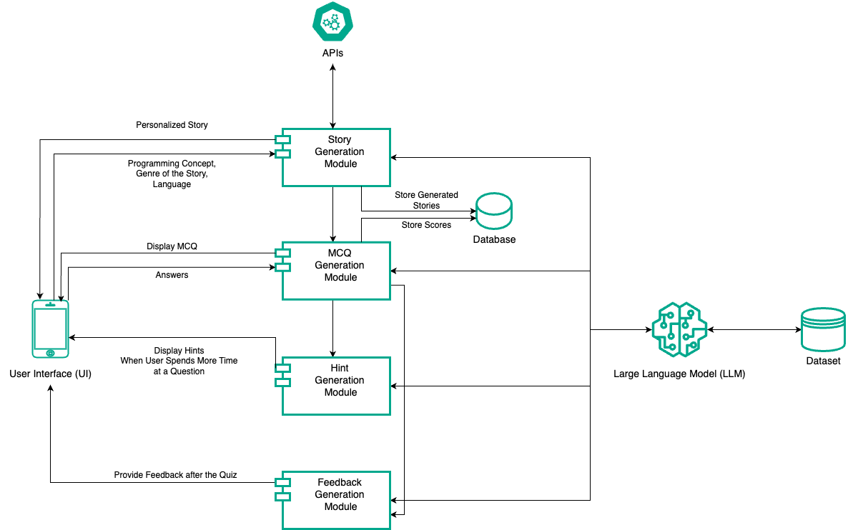
Methodology
System Diagram
IT21023446 | Sanjeevan M.C.M.A | R24-109

Slide 12
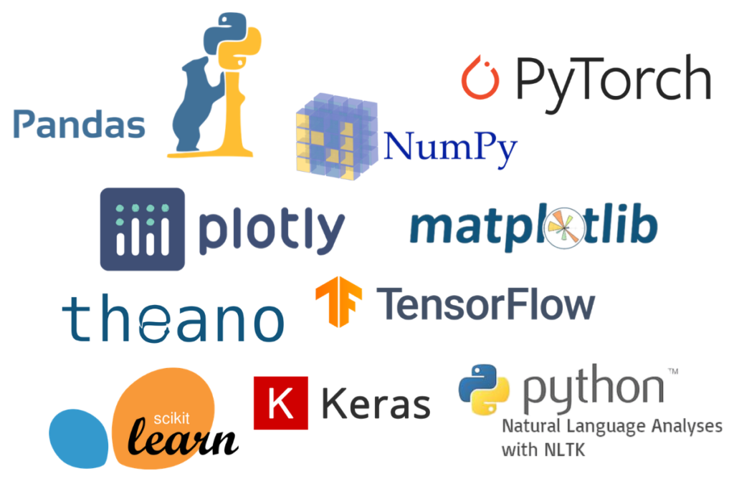
Methodology Cont’d
Technologies Used
Flutter
Python
LLM / GPT2
Libraries(Pandas, Torch, Transformers)
IT21023446 | Sanjeevan M.C.M.A | R24-109

Slide 13
What includes in 90%
User Interface Design
Backend Design
User Interface and Backend integration

Slide 14
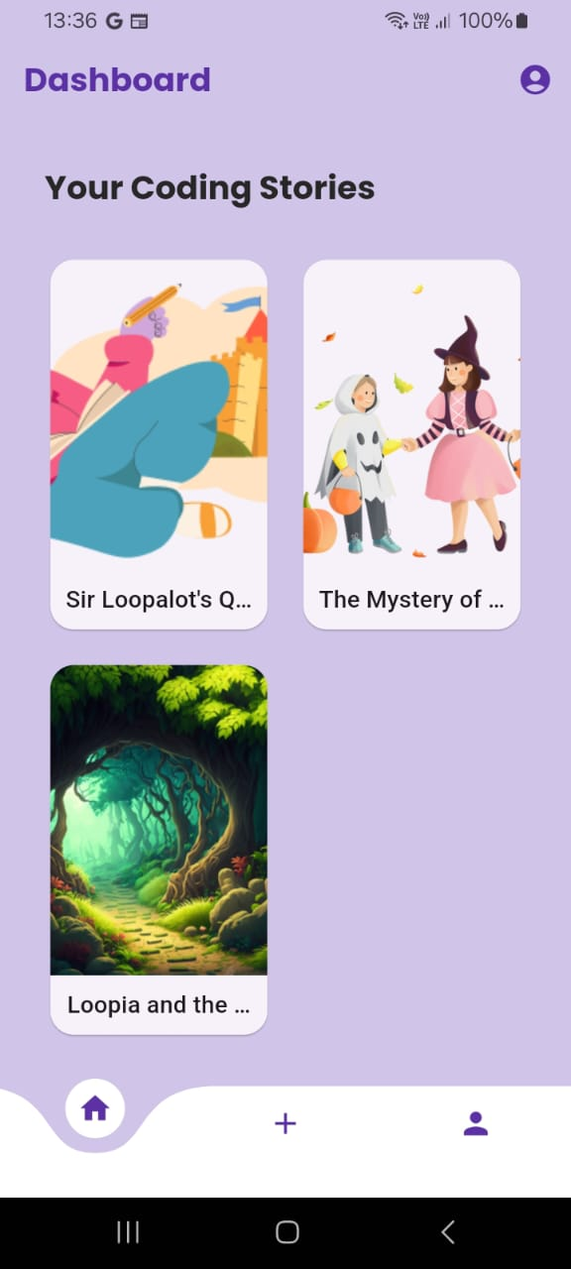
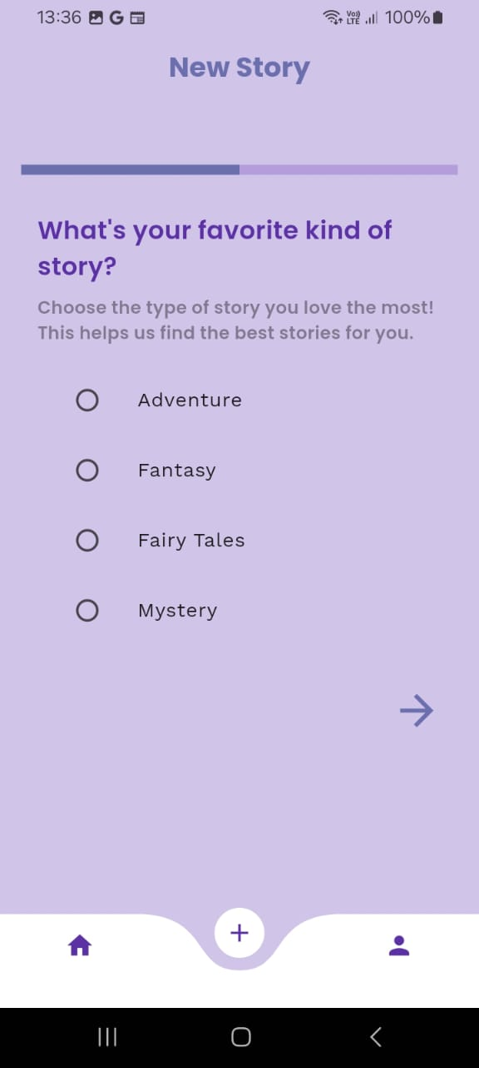
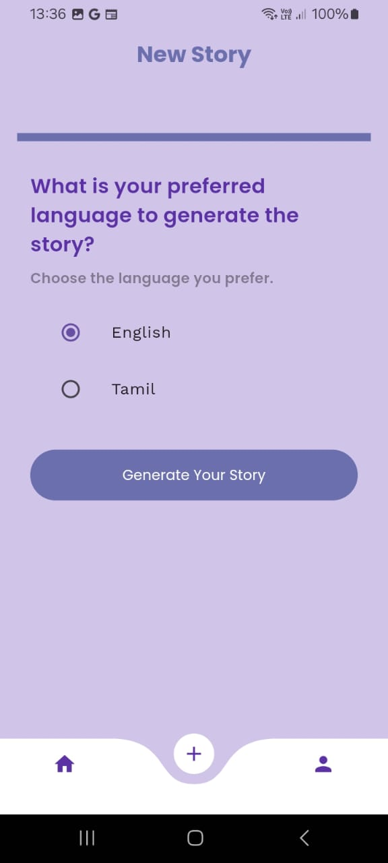
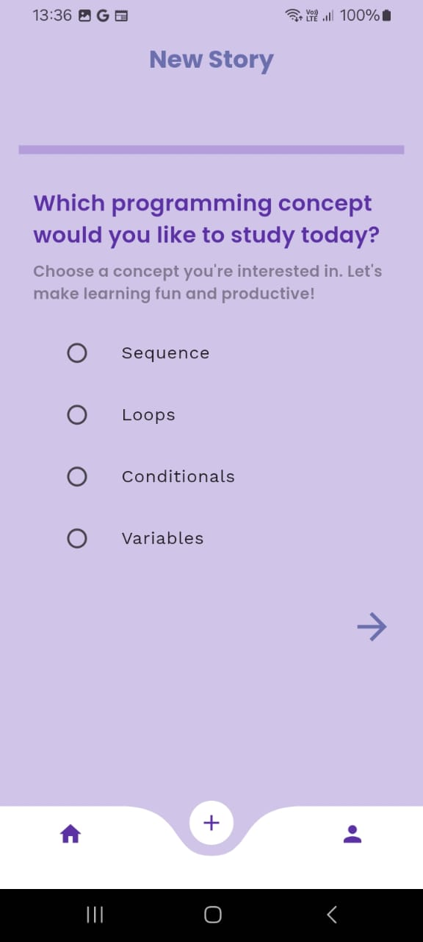
Front-end Implementation

Slide 15

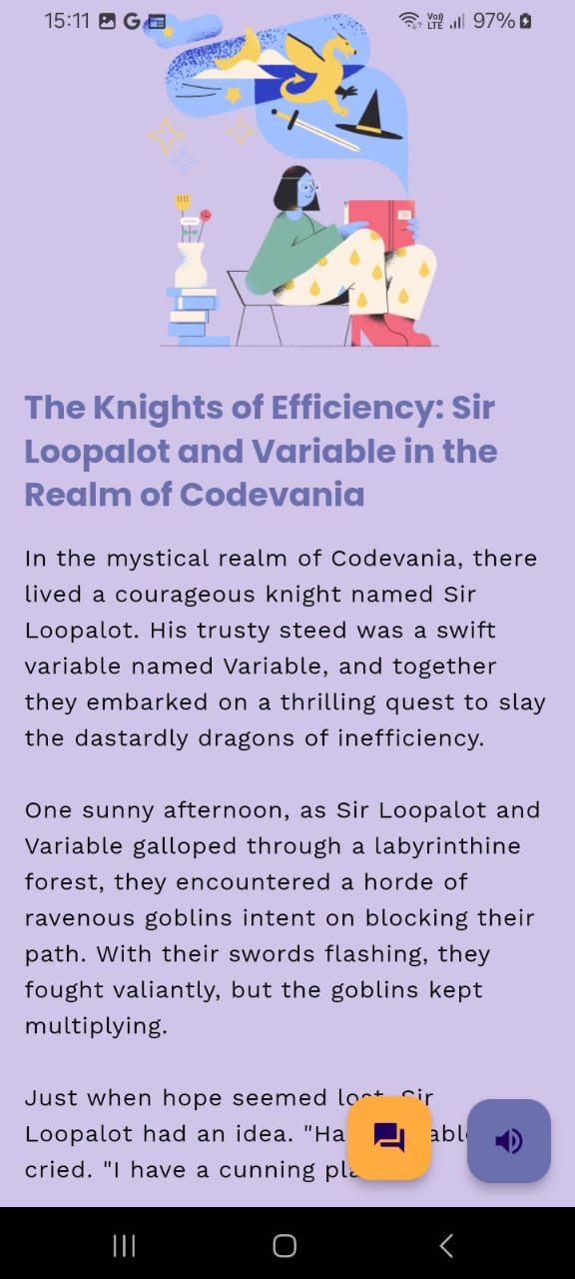
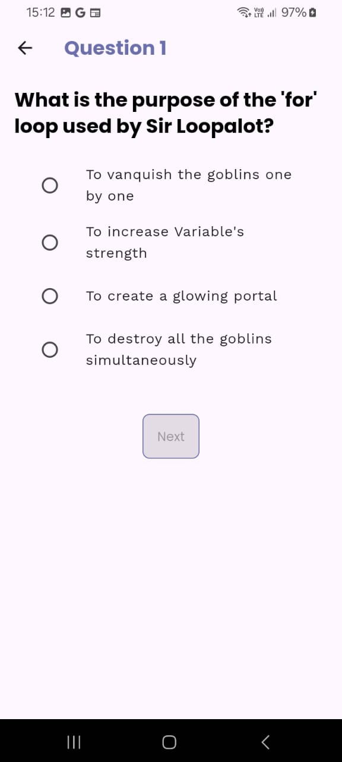
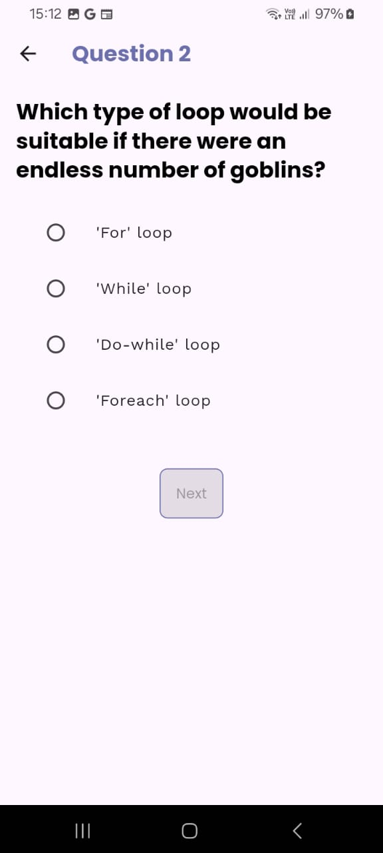
Front-end Implementation Cont’d

Slide 16
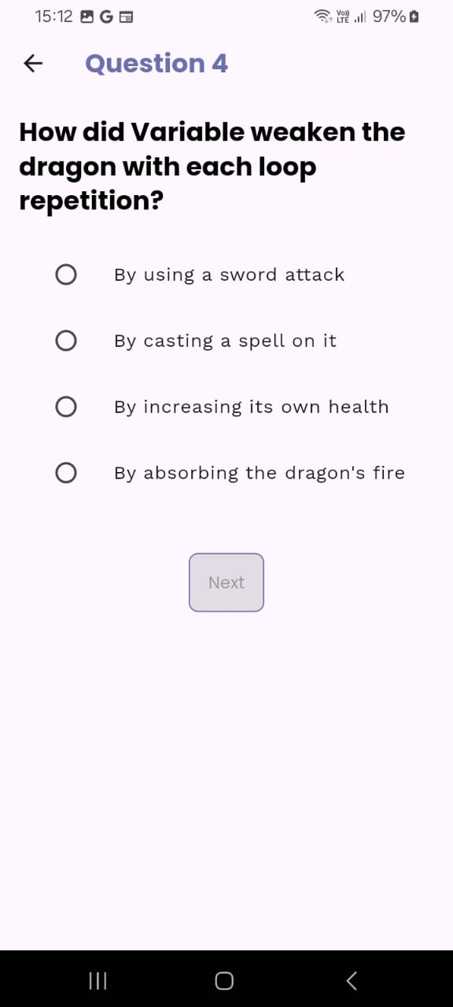
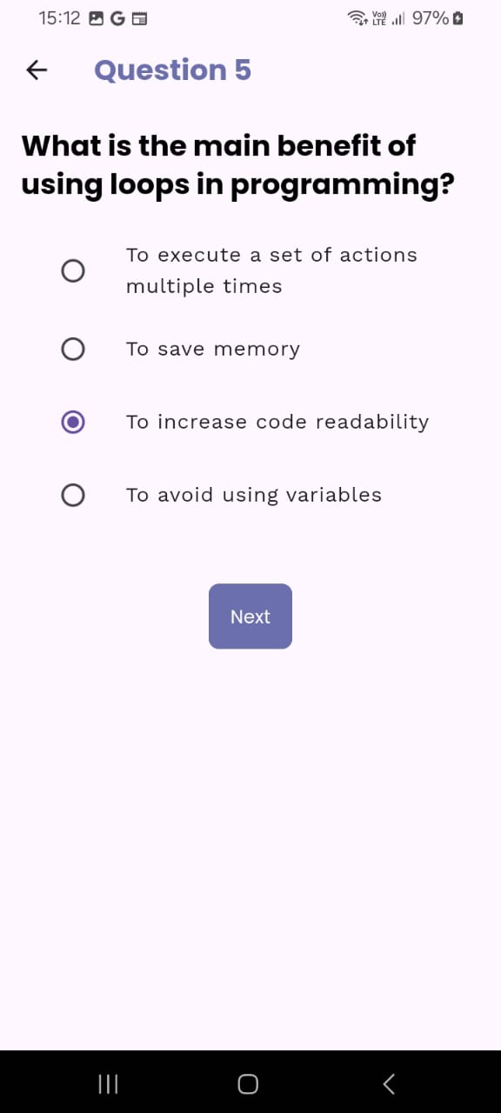
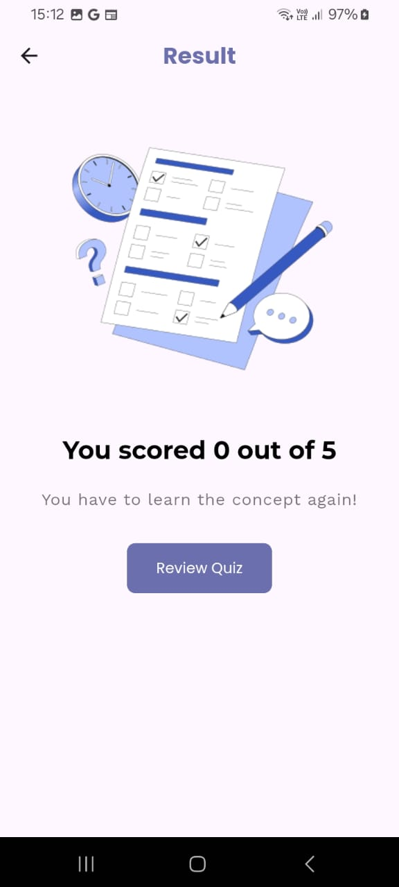
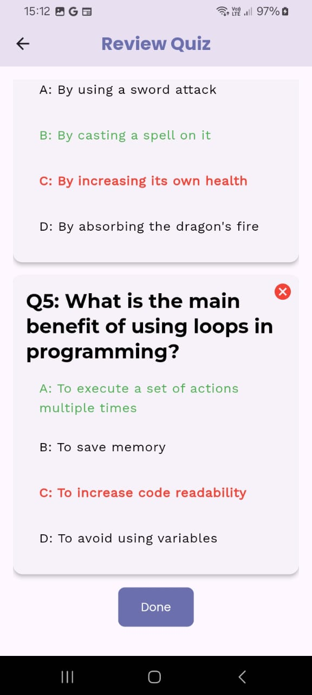
Front-end Implementation Cont’d

Slide 17
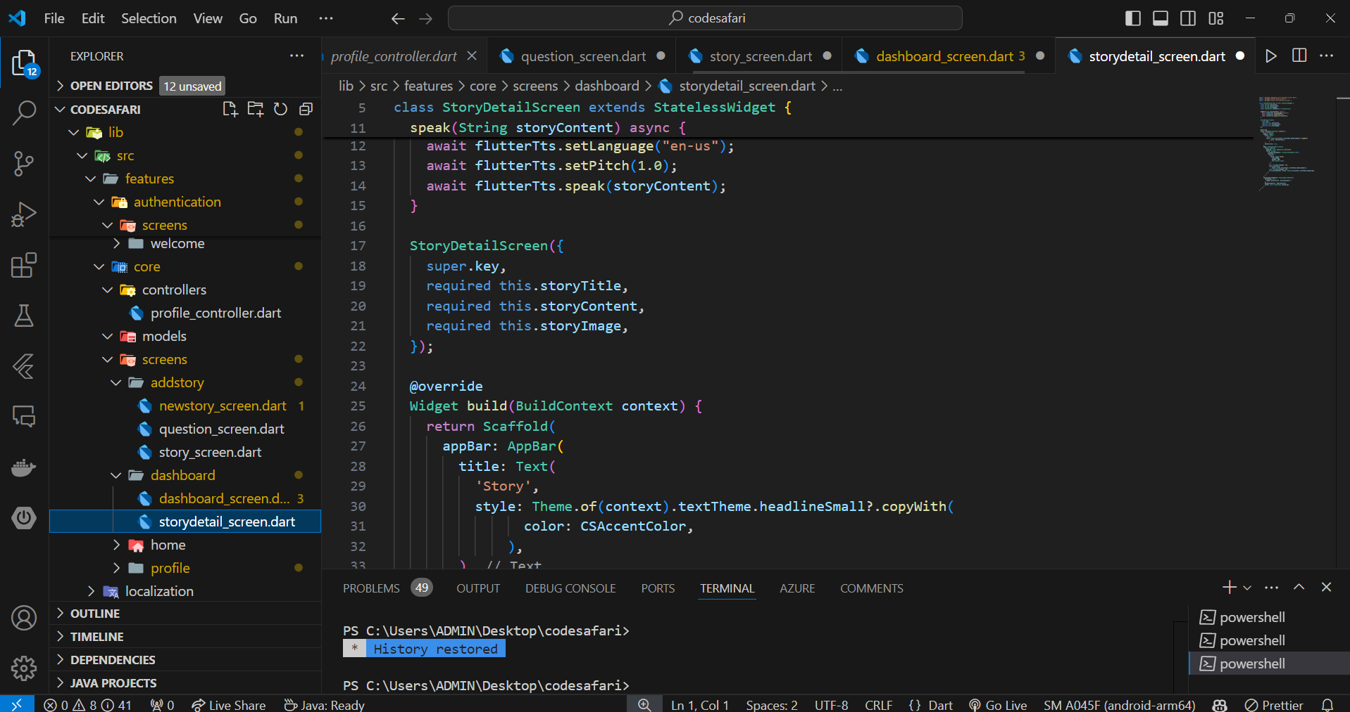
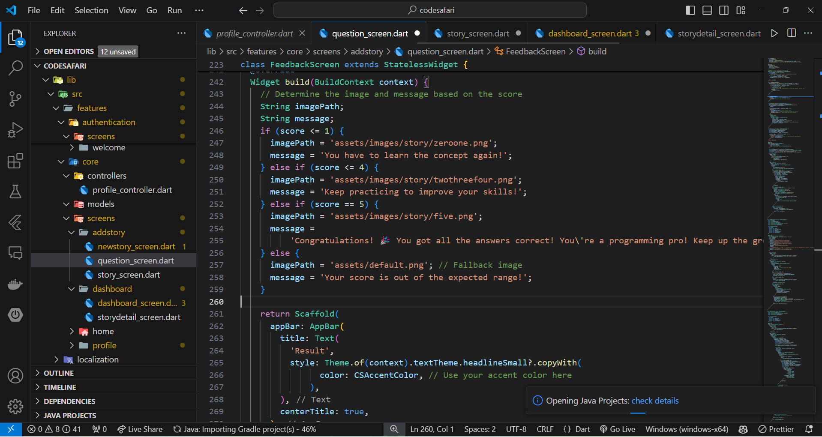
Back-end Implementation

Slide 18
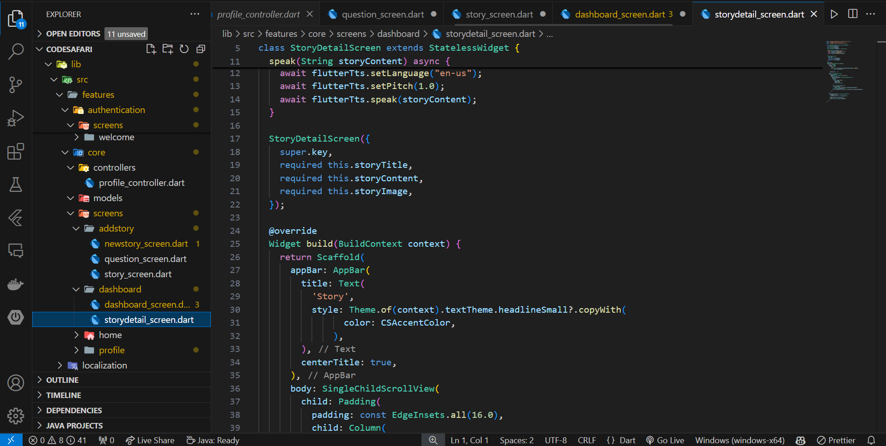
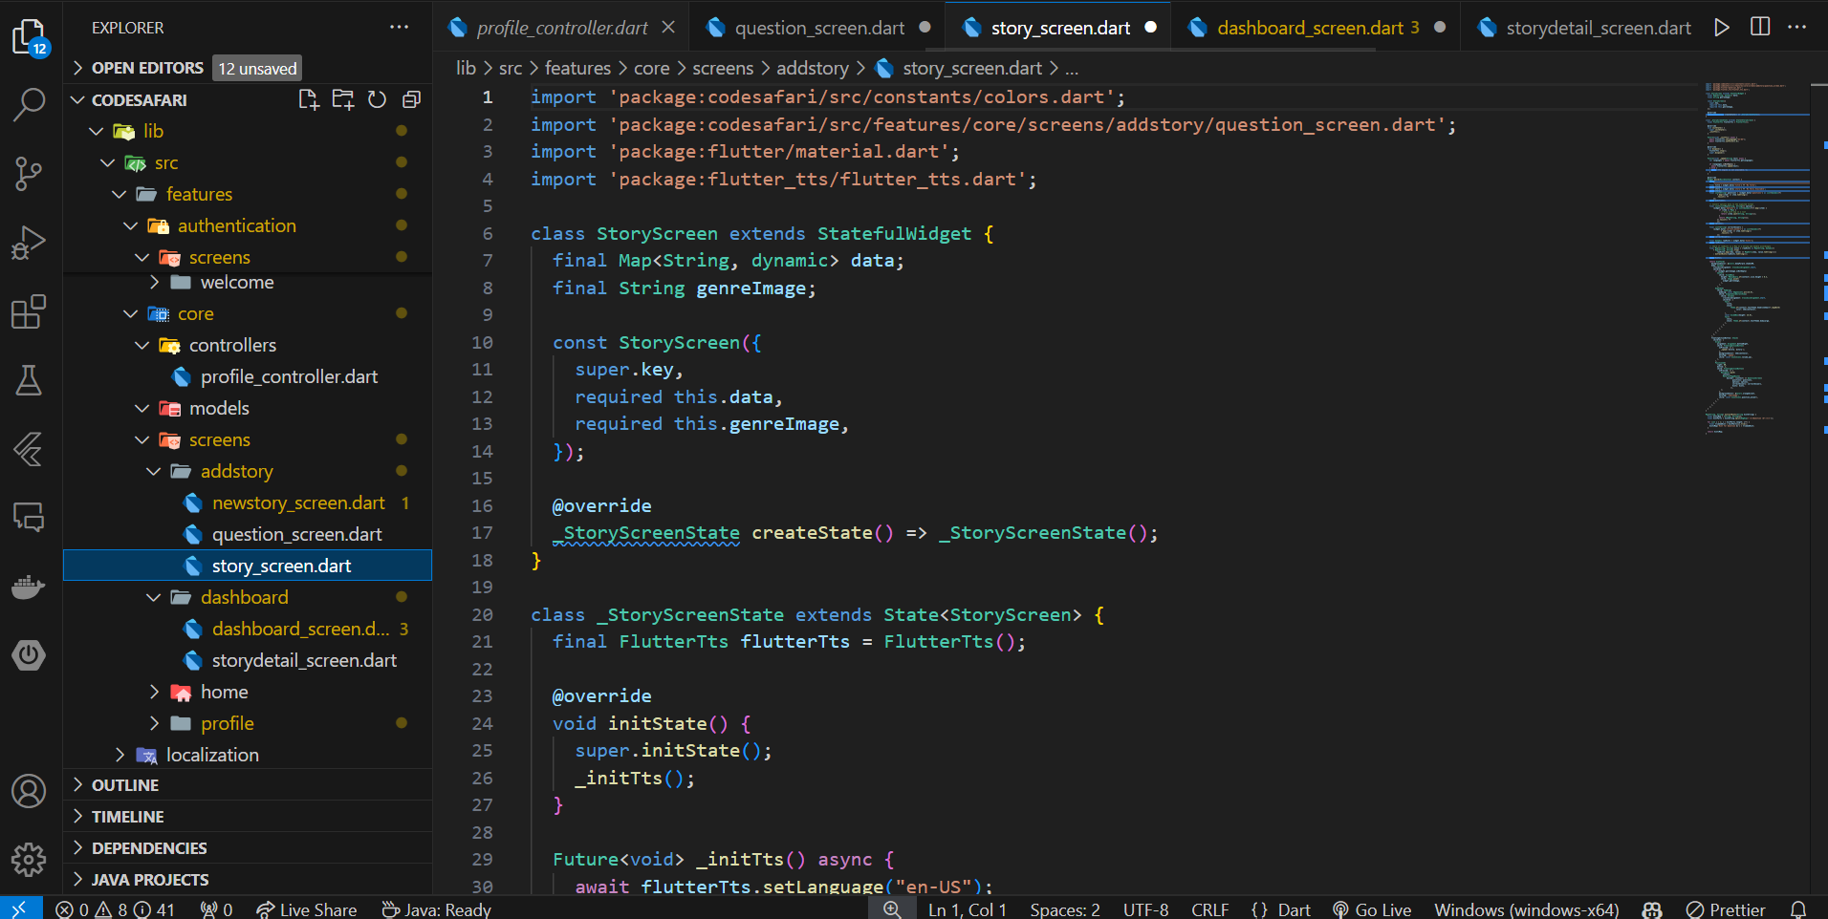
Back-end Implementation Cont’d

Slide 19
Next Expected Progress
Adding Some Gamified Features
Enhance User Interfaces
Web Application Hosting On Cloud
Commercialization

Slide 20
References
[5] Simões Gomes, Tancicleide Carina, et al. “Exploring an Approach Based on Digital Games for Teaching Programming Concepts to Young Children.” International Journal of Child-Computer Interaction, vol. 16, June 2018, pp. 77–84, https://doi.org/10.1016/j.ijcci.2017.12.005.
[6] Dietz, G., Le, J. K., Tamer, N., Han, J., Gweon, H., Murnane, E. L., & Landay, J. A. (2021). StoryCoder: Teaching computational thinking concepts through storytelling in a voice-guided app for children. In Proceedings of the 2021 CHI Conference on Human Factors in Computing Systems (pp. 1-15). ACM. [doi:10.1145/3411764.3445039]
[7] Ruan, S., He, J., Rui, J., Burkle, J., Hakim, D., Wang, A., Yufeng, L., Zhou, L., Xu, Q., AbuHashem, A., Dietz, G., Murnane, E. L., Brunskill, E., & Landay, J. A. (2020). Children's math learning with feedback-augmented narrative technology. In Proceedings of the 2020 ACM Conference on Human-Computer Interaction (pp. 567-580). ACM. [doi:10.1145/3334423.3377805]
[8] Maloney, J., Resnick, M., Rusk, N., & Silverman, B. (2008). The design and evaluation of programming systems for children. In CHI '08 Proceedings of the SIGCHI Conference on Human Factors in Computing Systems (pp. 1025-1034). ACM
[9] Garcia, P., Glassman, E., [et al.] (2022). "An Empirical Study of Mobile Programming Environments for Young Children," IEEE Transactions on Learning Technologies, 14(3), pp. 456-469.
IT21023446 | Sanjeevan M.C.M.A | R24-109

Slide 21
References Cont’d
[10] M. Videnovik, A. M. Bogdanova, and V. Trajkovik, "Game-based learning approach in computer science in primary education: A systematic review, vol. 1, no. 100616, Jan. 2023. [Online]. Available: https://doi.org/10.1016/j.entcom.2023.100616
[11] "Improving Teaching and Learning Computer Programming in Schools through Educational Software." Olympiads in Informatics, vol. 11, pp. 55-75, 2017, doi:10.15388/ioi.2017.05
[12] Devananda Sreekanth and Dr. Nasrin Dehbozorgi Title: "AI-based Quiz Generation: The Role of LLMs in Digital Education" Conference: C-DAY FALL 2023 Year: 2023 DOI
[13] Abraham Karikari, Emmanuel Opoku Kumi, Ellen Afia Achiaa, and Juliet Adu, "The Impact of Using Mother Tongue as Instructional Language in Teaching and Learning of Mathematics in Rural Primary Schools: A Case Study of four selected Schools in Sefwi Akontombra District, Ghana," International Journal of Novel Research in Education and Learning, vol. 9, issue 1, pp. 26-38, January-February 2022
[14] Smith, J., & Johnson, A. (2023). "Generating Multiple Choice Questions for Computing Courses Using Large Language Models." IEEE Transactions on Education, 10(5), 123-135. DOI: 10.1109/TE.2023.456789.
[15] Z. Zhao et al., "More human than human: LLM-generated narratives outperform human-LLM interleaved narratives," in Proceedings of the 15th Conference on Creativity and Cognition (C&C '23), June 2023, pp. 368-370, doi: 10.1145/3591196.3596612.
IT21023446 | Sanjeevan M.C.M.A | R24-109

Slide 22

Customized Kids Assisting system IT21037306 | Fahmi M.F.A.
Software Engineering Specialization
IT21037306 | Fahmi M.F.A. | R24-109

Slide 23
Research Questions ?
How to assist kids when they are getting doubts ?
How to get input from kids ?
How to provide the suitable answer for their doubts ?
How to identify the kids questions even those are not properly structed?
What are the ways to provide the answers?
IT21037306 | Fahmi M.F.A. | R24-109

Slide 24
Specific and Sub Objectives
Develop a customized kids' assistance system to provide real-time support for learning challenges by implementing a structured breakdown of identified problems and promote their critical thinking.
Design a interactive and user-friendly interface for kids.
Get the input from kids (Voice / Image) and Transfer it to Text Format.
Translate the text to English if it’s from another language.
Design a flexible and expandable KBA
KBA (Knowledge Based Agent)
Provide a compact answer to kid’s doubts.
IT21037306 | Fahmi M.F.A. | R24-109

Slide 25
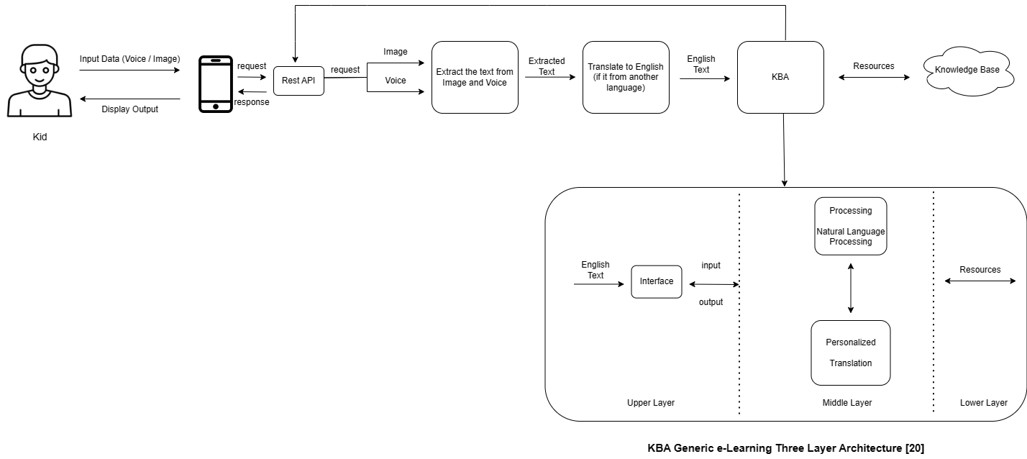
Methodology
System Diagram
IT21037306 | Fahmi M.F.A. | R24-109

Slide 26
Methodology Cont’d
Technologies Used
Flutter
Python
RASA
Libraries (NLTK, Deep Translator, Flask, PyTorch, Numpy, scikit-learn)
IT21037306 | Fahmi M.F.A. | R24-109

Slide 27
What includes in 90%
User Interface Design
Backend Design
User Interface and Backend integration

Slide 28
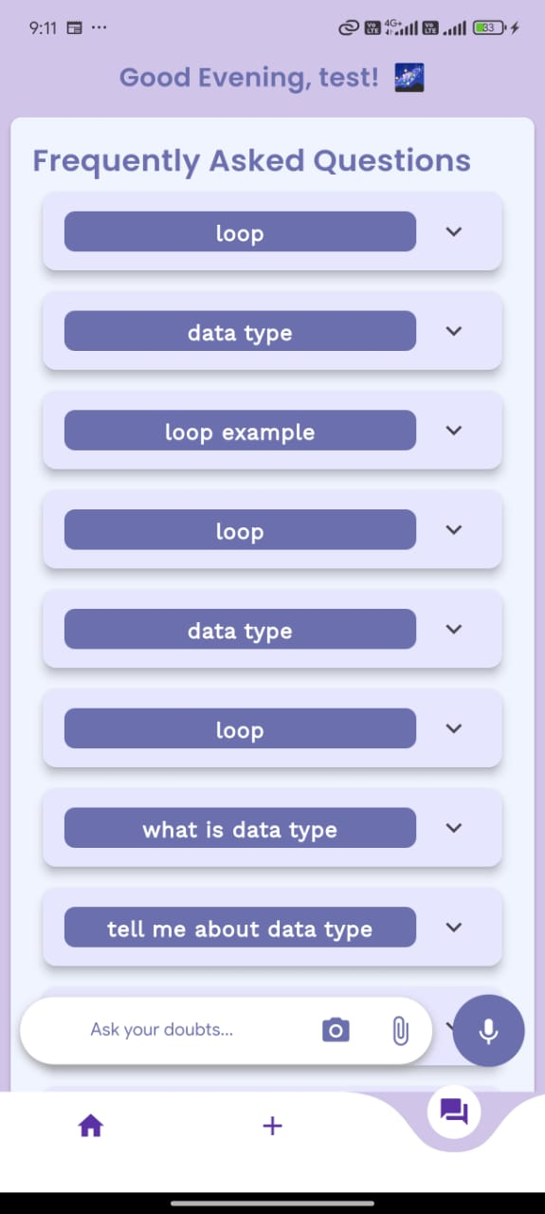
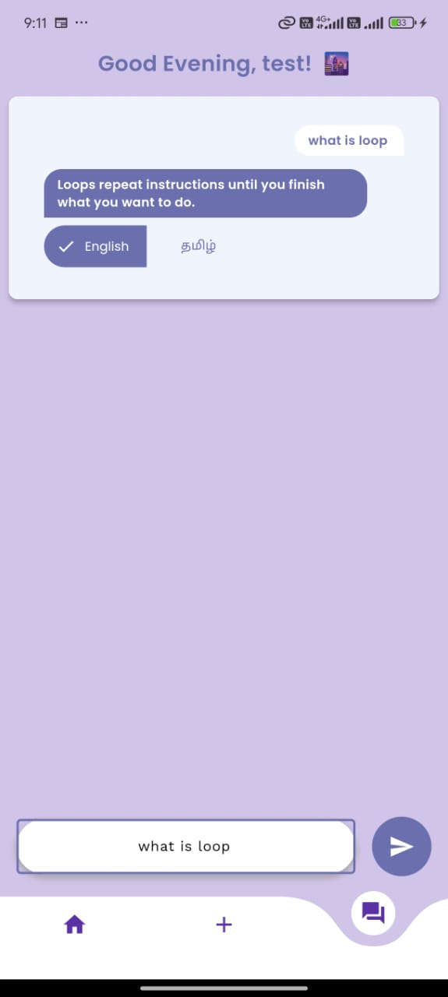
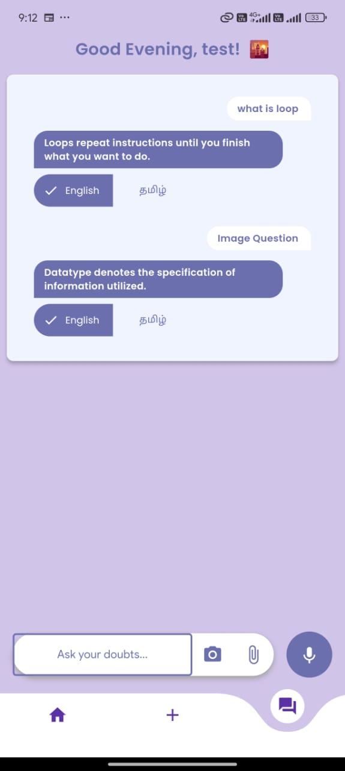
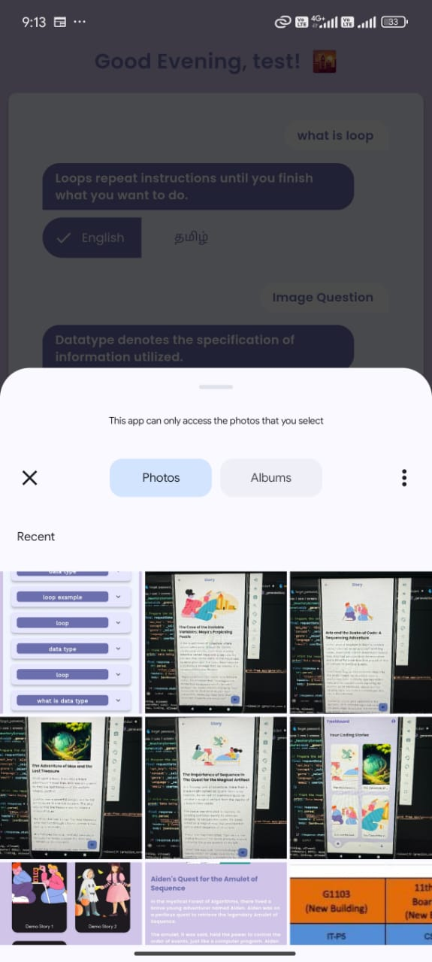
Front-end Implementation

Slide 29
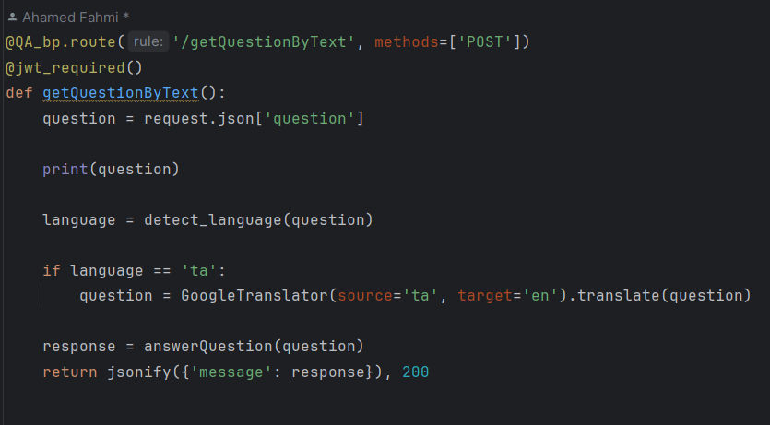
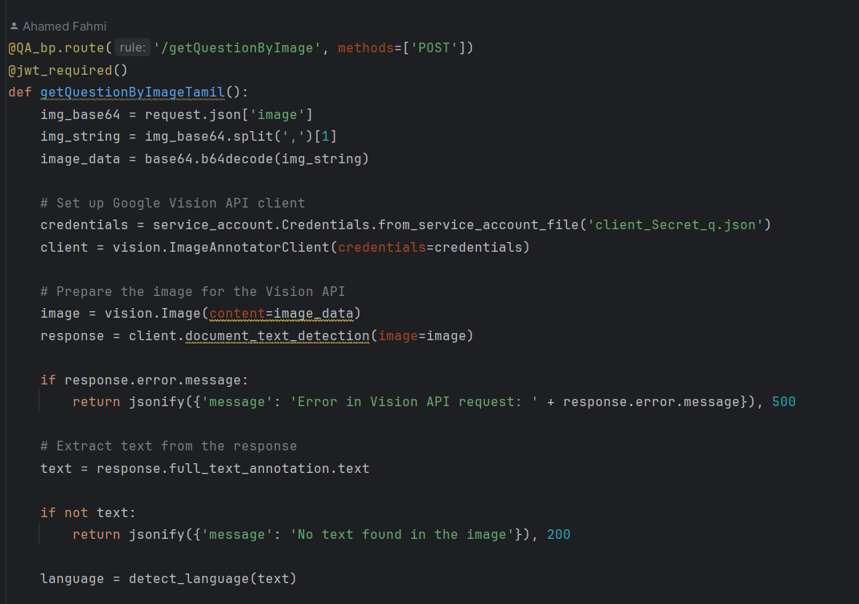
Back-end Implementation
IT21037306 | Fahmi M.F.A. | R24-109

Slide 30
Next Expected Progress
Enhance the state management of app
Add some user-friendly messages
Improve the UI
Commercialization
Release app on Play Store

Slide 31
References
[16] Researchgate.net. [Online]. Available: https://www.researchgate.net/profile/Azzam_Sleit/publication/344540445_2017_-_DISCRETE_TIME_EVENTS_REPRESENTATION_using_mapreduce/links/5f7edc50458515b7cf6f5902/2017-DISCRETE-TIME-EVENTS-REPRESENTATION-using-mapreduce.pdf#page=25. [Accessed: 20-Feb-2024].
[17] Researchgate.net. [Online]. Available: https://www.researchgate.net/profile/Harco-Leslie-Hendric-Spits-Warnars/publication/343305550_Learning_Math_through_Mobile_Game_for_Primary_School_Students/links/5facc43ba6fdcc9389ab3858/Learning-Math-through-Mobile-Game-for-Primary-School-Students.pdf. [Accessed: 20-Feb-2024].
[18] Researchgate.net. [Online]. Available: https://www.researchgate.net/profile/Kithusshand-Raveendran/publication/377209836_International_Journal_of_Advanced_Research_and_Publications_Digital_Learning_For_Kids/links/659a59523c472d2e8eb9827e/International-Journal-of-Advanced-Research-and-Publications-Digital-Learning-For-Kids.pdf. [Accessed: 20-Feb-2024].
[19] Hussain, Azham & Najahah, Abdul. (2013). LITTLE PROFESSOR: A MOBILE LEARNING GAME FOR KIDS.
[20] K. Sakthiyavathi and K. Palanivel, “A generic architecture for agent based E-learning system,” in 2009 International Conference on Intelligent Agent & Multi-Agent Systems, 2009, pp. 1–5.
[21] H. S. A. Latiff, R. Razali, and F. F. Ismail, “User interface design Guidelines for Children Mobile learning Applications,” International Journal of Recent Technology and Engineering, vol. 8, no. 3, pp. 3311–3319, Sep. 2019, doi: 10.35940/ijrte.c5434.098319.
IT21037306 | Fahmi M.F.A. | R24-109

Slide 32

Level-based IT Fundamental Knowledge Evaluation IT20275006 | Lakpriya K.H.A.V
Software Engineering Specialization
IT20275006 | Lakpriya K.H.A.V | R24-109

Slide 33

Research Questions ?
Ineffective Assessment and Evaluation Methods
Standard evaluation techniques often fail to accurately capture a student's true understanding of IT concepts or their ability to apply this knowledge practically.
Limited Engagement and Motivation in IT Learning
Maintaining student interest and motivation in IT subjects, especially among younger learners,
remains a significant challenge.
Inefficient Resource Allocation in IT Education
There's a lack of tools that provide comprehensive, real-time data on student progress and areas
needing intervention.
IT21037306 | Fahmi M.F.A. | R24-109

Slide 34

Specific and Sub Objectives
Developing a comprehensive and personalized evaluation system that leverages machine learning techniques to assess and reinforce young learners' knowledge of fundamental IT concepts
Implement a leveled assessment framework with progressive difficulty levels
Develop and integrate machine learning models
Predicting Passing Marks (Regression Model) Decision on Level Skipping (Classification Model) Evaluating IT Knowledge (Regression Model) Customizing Questions (Recommendation System)
Establish Data Collection and Analysis System
IT20275006 | Lakpriya K.H.A.V | R24-109

Slide 35
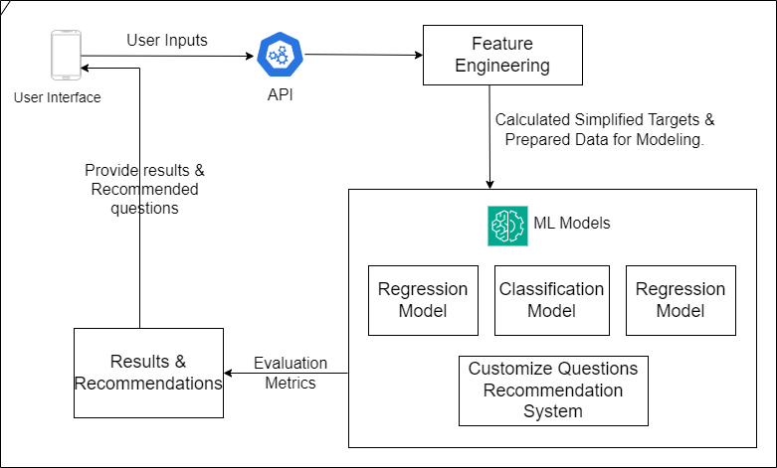
Methodology
System Diagram
IT21023446 | Sanjeevan M.C.M.A | R24-109

Slide 36







Methodology Cont’d
Technologies Used
Flutter
Python
Libraries(Pandas, NumPy, PyTorch, matplotlib)
IT21023446 | Sanjeevan M.C.M.A | R24-109

Slide 37
What includes in 90%
User Interface Design
Backend Design
User Interface and Backend integration

Slide 38
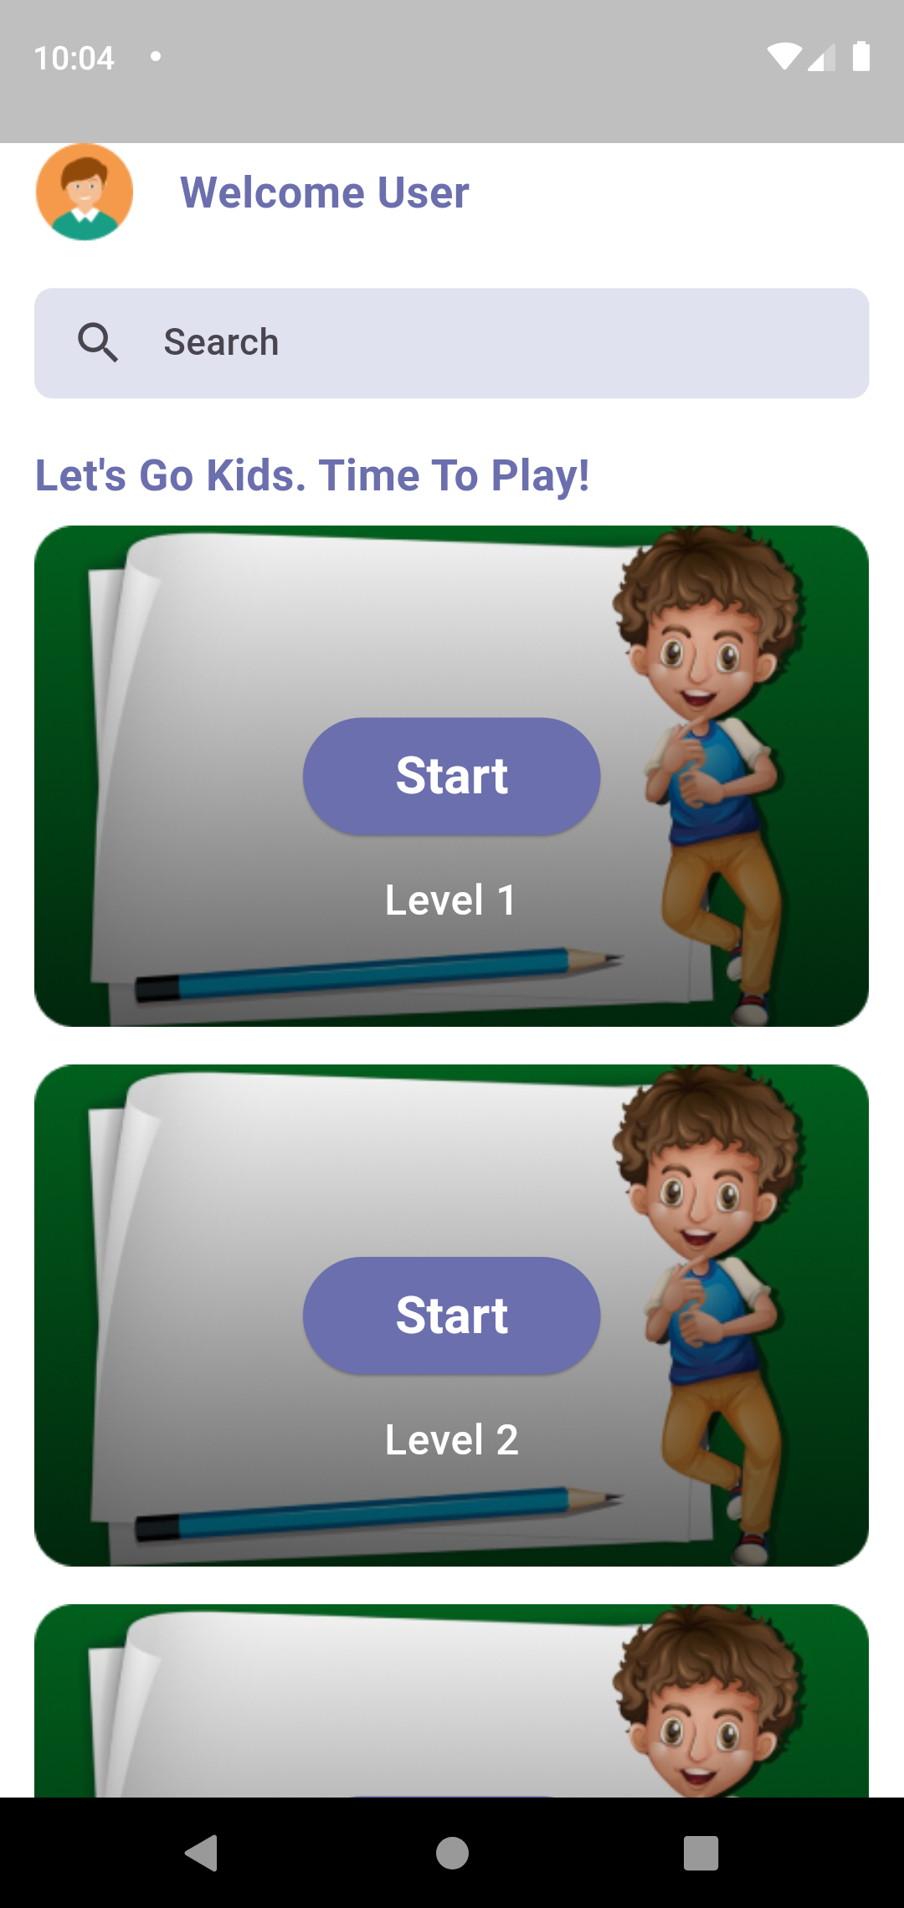
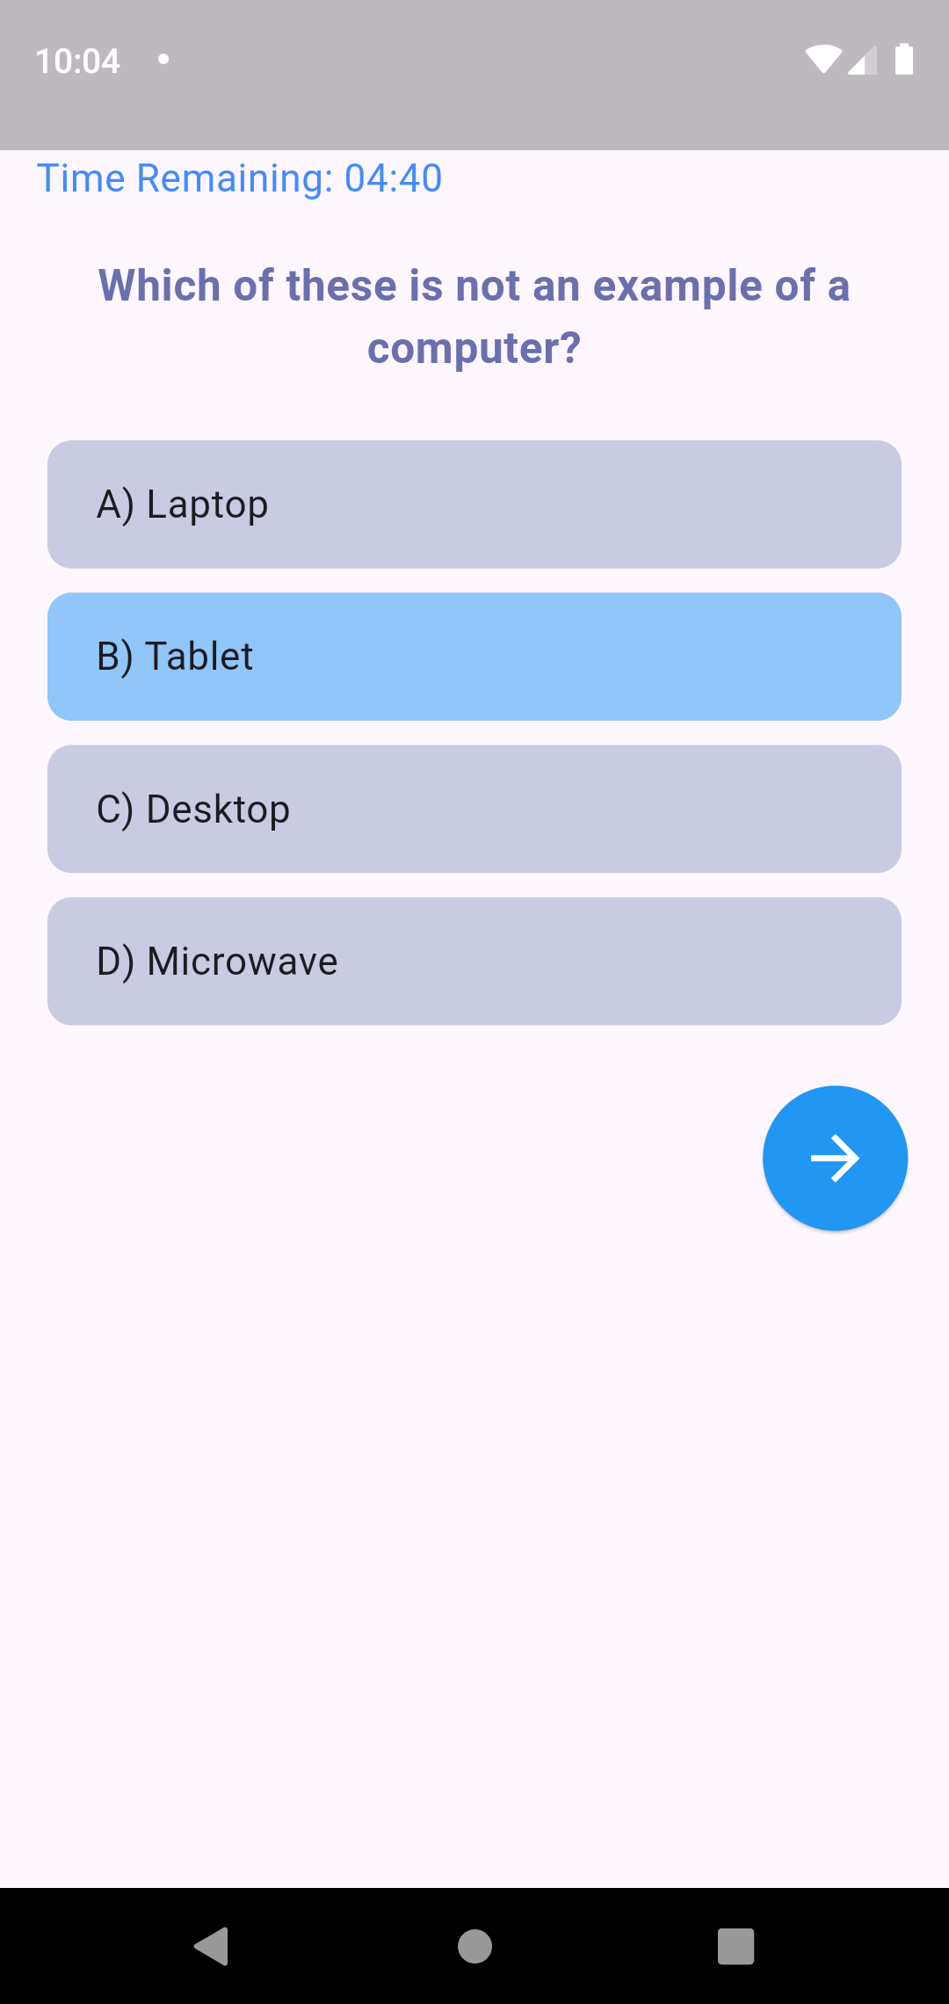
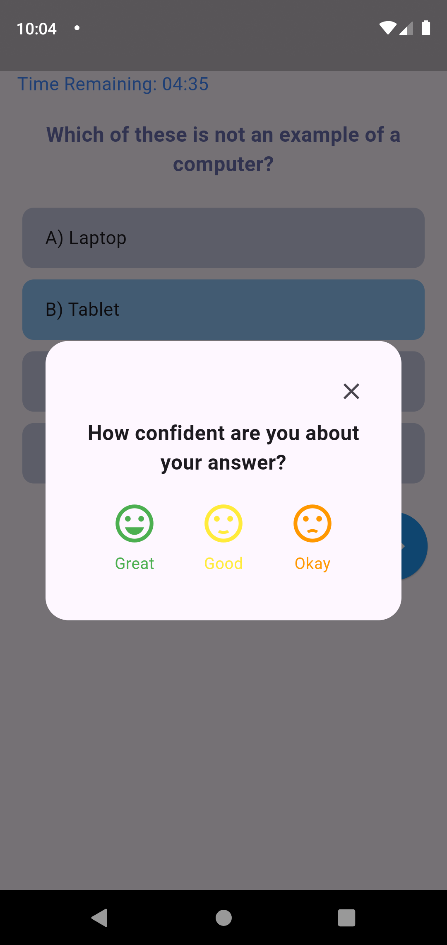
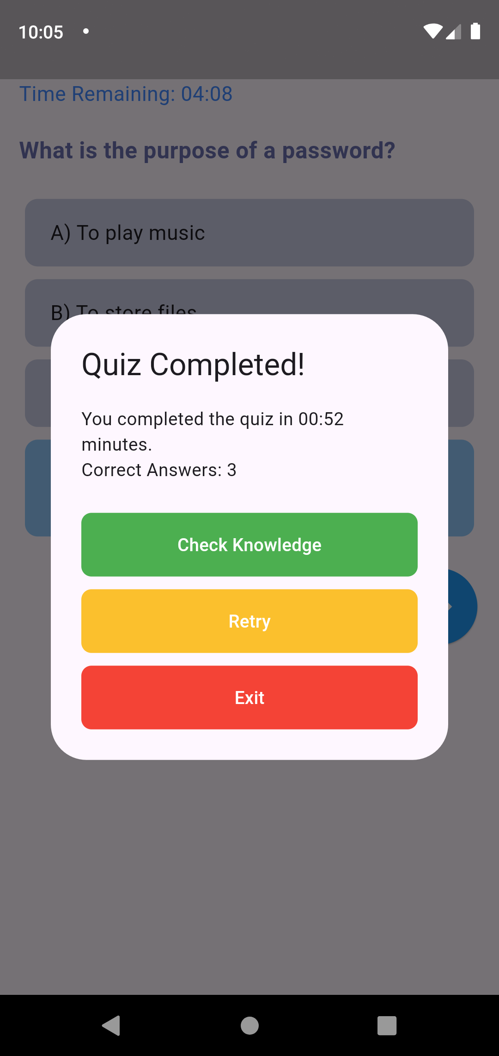
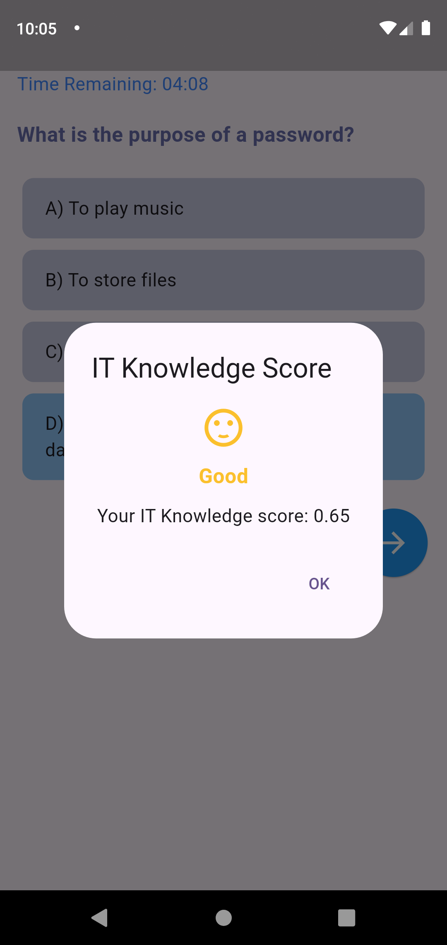
Front-end Implementation

Slide 39
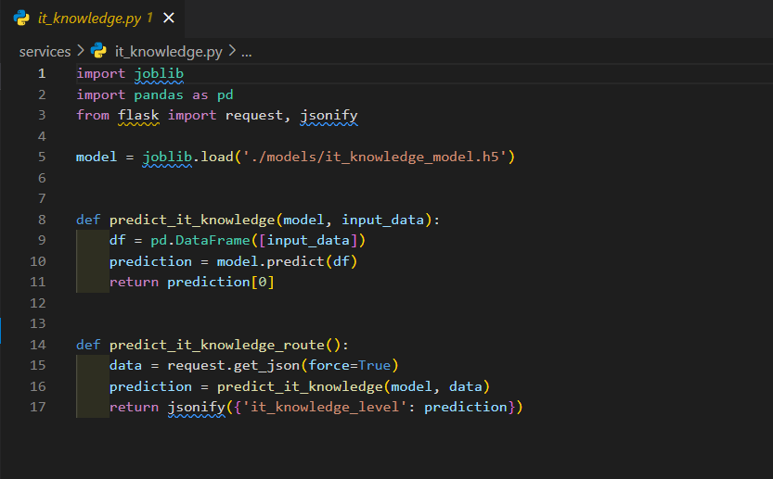
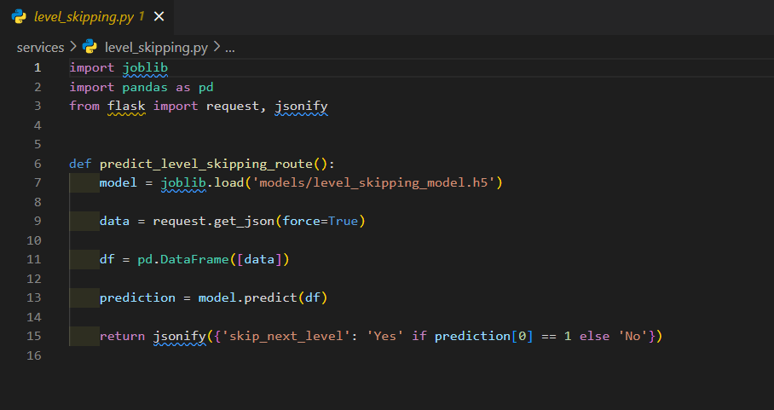
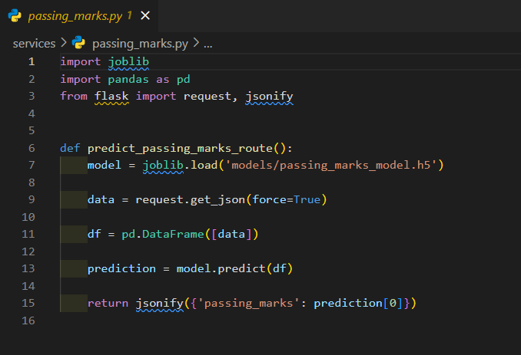
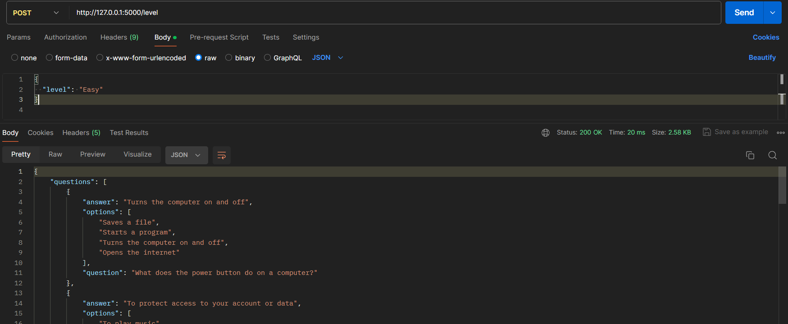
Back-end Implementation

Slide 40
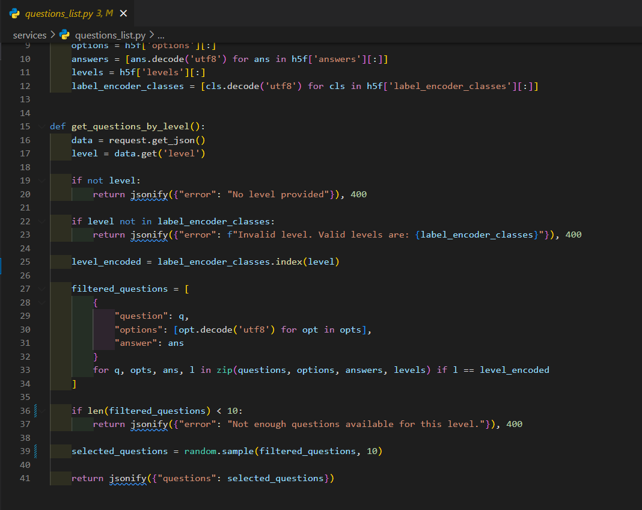
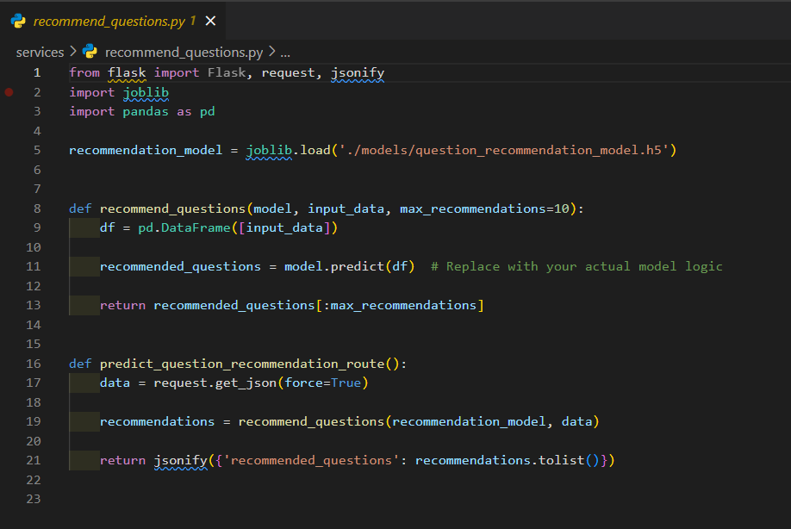
Back-end Implementation

Slide 41

Next Expected Progress
Add Some Set of Advance IT Fundamental Questions With More Levels
Add Some Difficulty Levels
Enhance User Interfaces
Commercialization

Slide 42
References
[22] A. &. K. J. Alkhatlan, “A Comprehensive Historical Survey with Recent Developments. International Journal of Computer Applications,” Intelligent Tutoring Systems, vol. 181(43), pp. 1-20, 2018.
[23] J. e. a. Huang, “An adaptive learning system for enhancing student performance in introductory programming courses.,” Computer Applications in Engineering Education, vol. 28(5), pp. 1260-1279, 2020.
[24] A. e. a. Hellas, “Predicting Academic Performance: A Systematic Literature Review.,” Proceedings Companion of the 23rd Annual ACM Conference on Innovation and Technology in Computer Science Education, pp. 175-199, 2018
[25] E. B. e. a. Costa, “Evaluating the effectiveness of educational data mining techniques for early prediction of students' academic failure in introductory programming courses.,” Computers in Human Behavior,, vol. 73, pp. 247-256.
[26] A. e. a. Lagunes, “A personalized recommendation system for learning programming.,” Telematics and Informatics, vol. 58, p. 101534, 2021.
[27] L. e. a. Zhang, “CodeMentor: Intelligent Tutoring for Programming Education,” Proceedings of the 52nd ACM Technical Symposium on Computer Science Education, pp. 1025-1031, 2021.
[28] P. e. a. Ihantola, “Review of recent systems for automatic assessment of programming assignments.,” Proceedings of the 10th Koli Calling International Conference on Computing Education Research, pp. 86-93., 2015.
IT20275006 | Lakpriya K.H.A.V | R24-109

Slide 43

Teaching programming with real life examples IT21084522 | DISSANAYAKE A. L.
Software Engineering Specialization
IT21084522 | Dissanayake A. L. | R24-109

Slide 44

Introduction
This study explores the transformative impact of a Project and Quizzes Based Programming Learning App on school students in grades 6 to 8. The research emphasizes key elements such as skill development, practical application, and the use of real-life examples to teach coding concepts. Quizzes, fill-in-the-blanks exercises, and projects were assigned to reinforce learning, along with real-time language translation for peer feedback and group problem-solving. Additionally, it examines the machine learning model’s effectiveness in tailoring individual projects. By employing both quantitative and qualitative approaches, the study aims to uncover long-term learning outcomes, assess user satisfaction, and understand the role of ethical considerations in enhancing student engagement and learning.
IT21084522 | Dissanayake A. L. | R24-109

Slide 45

Research Questions ?
Does the Project-Based Programming Learning App impact
School students' skills?
What's the app's role in practical application and real-time language translation?
How effective is the machine learning model in analyzing students and assigning relevant projects?
What are the long-term outcomes and user satisfaction levels, and how does parental involvement contribute?
How do ethical coding consideration elements influence student learning?
IT21084522 | Dissanayake A. L. | R24-109

Slide 46
Research Gap
Research Papers | Methodology | Technology | Gap | Solution
Project-Based Learning Approach for Teaching Mobile Application Development Using Visualization Technology [32] | No | No | Lacks assessing students and recommending projects | The solution will include a model that rates the student and recommend a suitable project
App-based learning for kindergarten children at home [33] | Yes | Yes | No real-time translation or peer communication | The solution will make it easier for students to communicate with peers in many languages
A review of Project-Based Learning (PBL) and Computational Thinking (CT) in teaching and learning [34] | Yes | No | Lacks uncover long-term learning outcomes, assess user satisfaction, gauge parental involvement | The solution will assess long-term learning outcomes, user satisfaction and how parental involvement influences
IT21084522 | Dissanayake A. L. | R24-109

Slide 47

Specific and Sub Objectives
Develop a system that assesses the improvement in practical application and problem-solving abilities among elementary school students participating in the project-based programming learning app with real life examples, utilizing specific metrics to measure collaborative problem-solving effectiveness.
Generate Concepts and Projects for kids to answer
Being able to verify the answers for the above-mentioned tasks.
Design a user-friendly application
Improving Skill development and Practical Application of kids.
Evaluating and assessing the overall impact of the system.
IT21084522 | Dissanayake A. L. | R24-109

Slide 48
What includes in 90%
User Interface Design
Backend Design
User Interface and Backend integration
IT21084522 | Dissanayake A. L. | R24-109

Slide 49
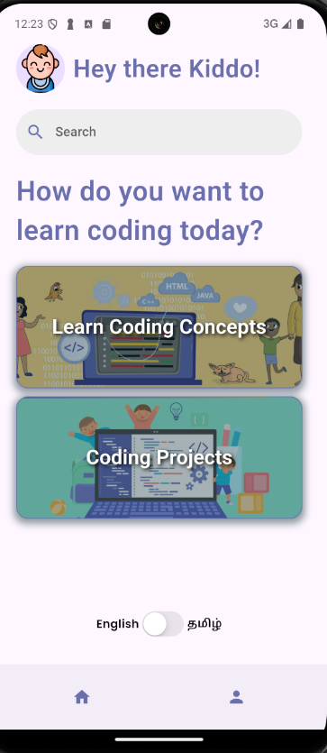
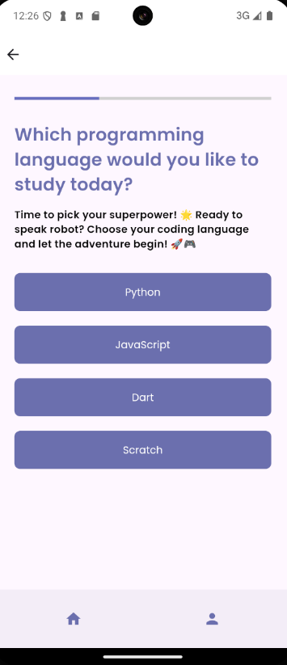
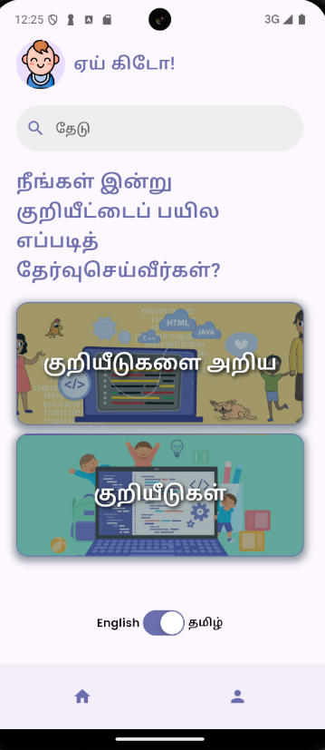
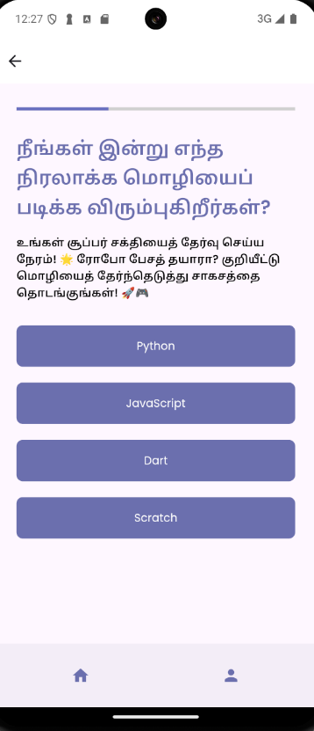
Front-end Implementation

Slide 50
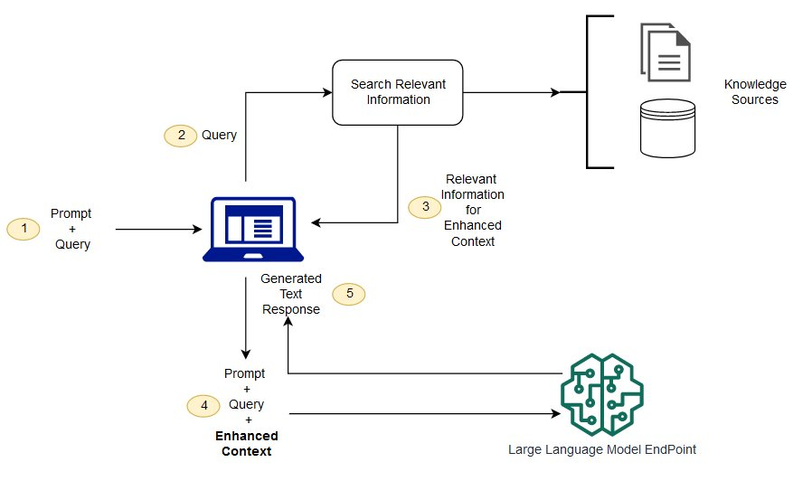
Architecture Diagram
Retrieval augmented architecture diagram
IT21084522 | Dissanayake A. L. | R24-109

Slide 51
Methodology
System Diagram
IT21084522 | Dissanayake A. L. | R24-109

Slide 52
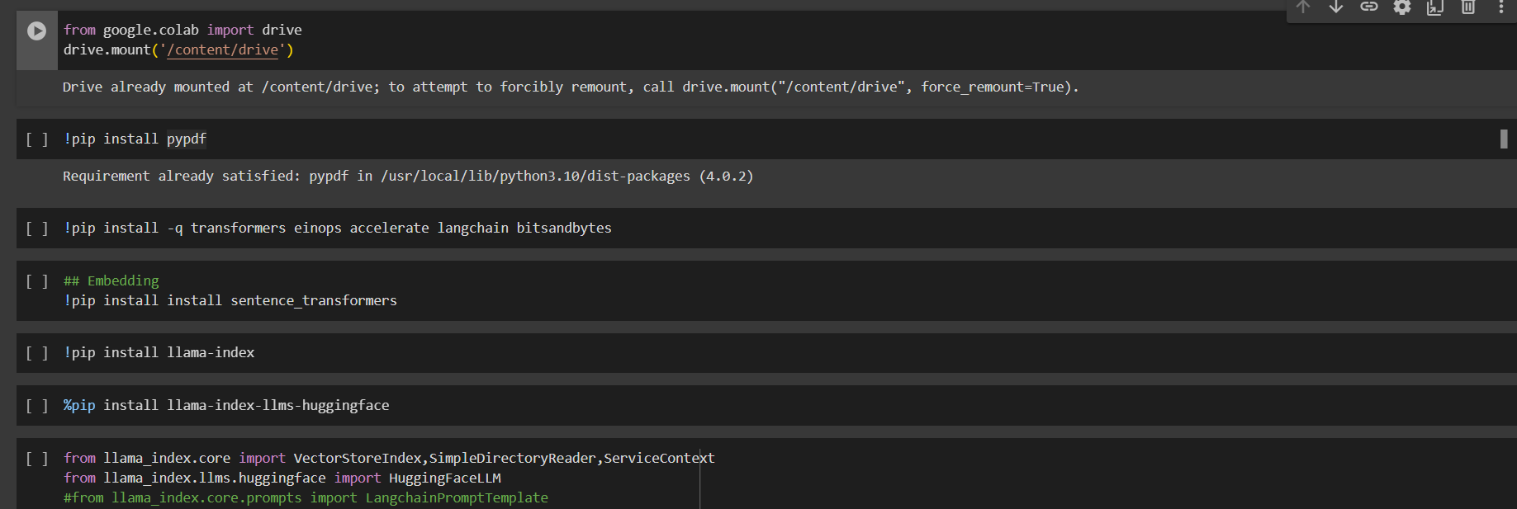
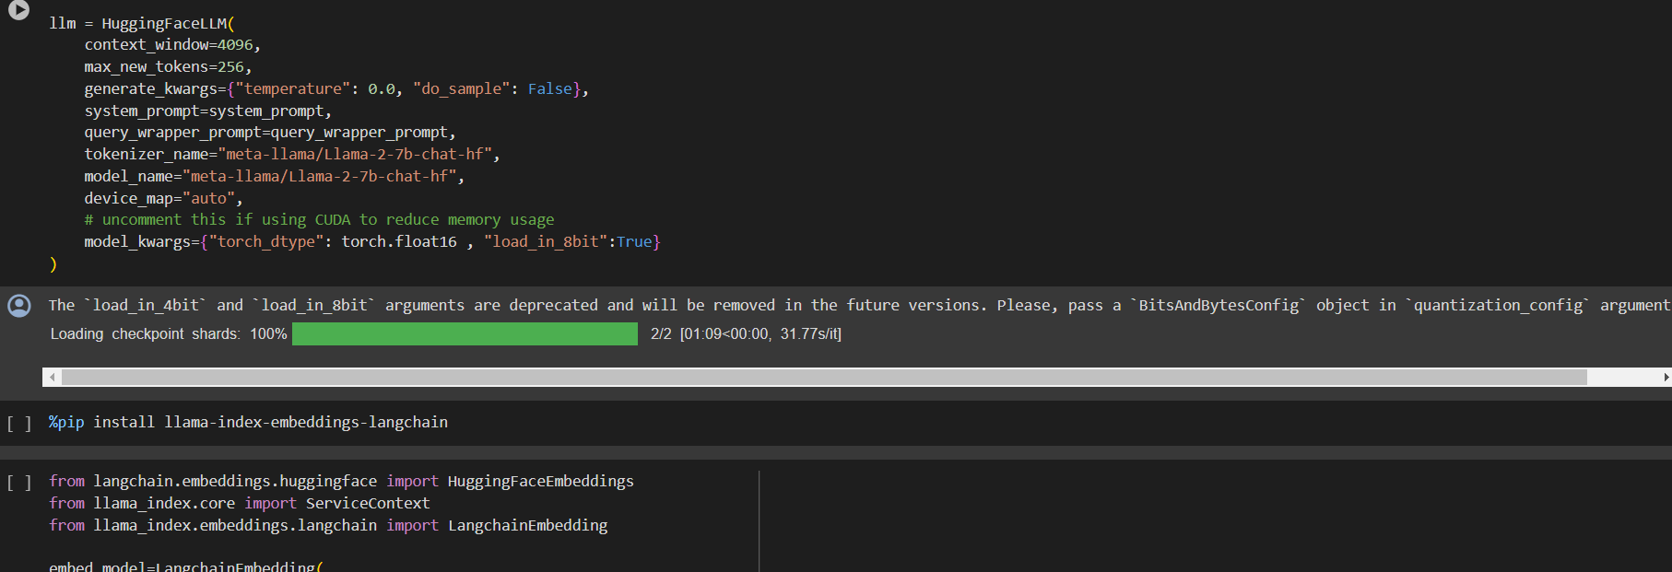
Methodology Cont'd
RAG model
IT21084522 | Dissanayake A. L. | R24-109

Slide 53
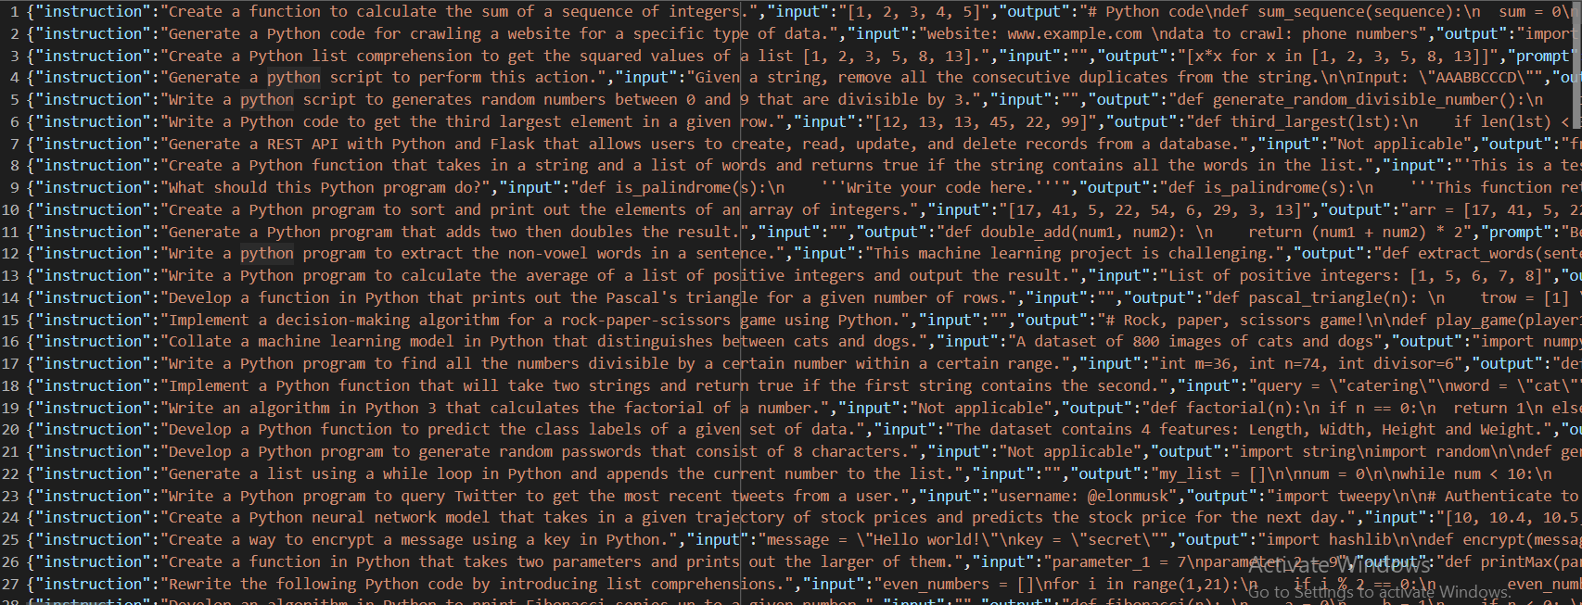
Methodology Cont'd
Model Dataset
IT21084522 | Dissanayake A. L. | R24-109

Slide 54



Methodology Cont’d
Technologies Used
Flutter
Llama
Libraries (PyTorch, Transformers, PEFT)
OpenAI Translator API
Python
IT21084522 | Dissanayake A. L. | R24-109

Slide 55
Methodology Cont’d
System Requirements
Functional Requirements | Non-Functional Requirements
User should be able to use project-based learning modules | Usability
User should be able to use real-time language translation | Performance
User should be able to collaborate and communicate with a group of kids | Scalability
User should be able to assess their skills | Security
IT21084522 | Dissanayake A. L. | R24-109

Slide 56
Methodology Cont’d
Future Plans
Improve UIs
Release on Play Store
Gather more user data
Finish the overall product
IT21084522 | Dissanayake A. L. | R24-109

Slide 57
Supporting Items
Budget
NO | Expenditure | Cost ($)
1 | Domain | 14.43$/M
2 | Hosting | 2.99$/M
3 | Traveling Expenses (4 Members ) | 12.84$/Trip
4 | Google Play Developer Fee | 25$ (One Time)
Total |  | 55.26$
IT21084522 | Dissanayake A. L. | R24-109

Slide 58

Supporting Items
Commercialization
Offer a subscription-based model
Licensing and Partnerships
Share on social media add
Make it shareable
IT21084522 | Dissanayake A. L. | R24-109

Slide 59
References
[30] “(PDF) Project-Based Learning Approach for teaching mobile application ...,” Project-Based Learning Approach for Teaching Mobile Application Development Using Visualization Technology, https://www.researchgate.net/publication/340901247_Project-Based_Learning_Approach_for_Teaching_Mobile_Application_Development_Using_Visualization_Technology (accessed Feb. 20, 2024).
[31] Author links open overlay panelAslina Saad a et al., “A review of Project-Based Learning (PBL) and Computational Thinking (CT) in teaching and learning,” Learning and Motivation, https://www.sciencedirect.com/science/article/abs/pii/S0023969022000224 (accessed Feb. 21, 2024).
[32] F. Niklas, E. Birtwistle, A. Wirth, T. Schiele, and A. Mues, “App-Based Learning for Kindergarten Children at Home (learning4kids): Study protocol for cohort 2 and the school assessments - BMC pediatrics,” BioMed Central, https://bmcpediatr.biomedcentral.com/articles/10.1186/s12887-022-03737-w (accessed Feb. 21, 2024).
IT21084522 | Dissanayake A. L. | R24-109

Slide 60
References
[1] https://www.bbc.com/news/world-61028138
[2] https://www.ncbi.nlm.nih.gov/pmc/articles/PMC9212225/
[3] https://icts.io/2023/09/08/top-3-outsourcing-countries-in-asia-india-philipines-and-vietnam
[4] https://timesofindia.indiatimes.com/india-fastest-growing-open-source-contributor-github/articleshow/81741376.cms?from=mdr

Slide 61
Thank-You

